Slide 1
When and How to Satisfice: An Experimental Investigation
John Hey, Nuttaporn Rochanahastin, yudistira permana

Slide 2
satisficing
This is what Simon was talking about in his famous 1955 QJE article “A Behavioral Model of Rational Choice”.
He introduced the idea of satisficing (and coined the word).
He talked about DM being satisfied if they reached a satisfactory aspiration level.
But he did not say where the aspiration level comes from.
Nor did he say why and when people choose to satisfice.

Slide 3
Manski’s 2017 paper
Manski (2017)’s paper in Theory and Decision has ‘satisficing’ in its title.
Manski (2017) explains when people choose to satisfice and how they choose their aspiration levels.
His theory could be classified as an extended search model, as distinct from Ambiguity, Imprecise or Incomplete Preferences or Rational Inattention explanations.
We experimentally test his model.

Slide 4
Manski’s paper
“Optimise, Satisfice, or Choose Without Deliberation?”: A Minimax-Regret Assessment”
This can be found here.
We think that it ‘breaks the mould’ – but it could just be his objective function.

Slide 5
Manski’s model 1
The DM has to choose an action from a known finite ordered choice set.
Associated with each action is a payoff – the DM is told only that these are between some lower bound L and some upper bound U.
The DM gets the payoff associated with the chosen action minus any costs in finding it.

Slide 6
Manski’s model 2
Manski has choice over strategies:
No deliberation
Satisfice with a set of (adaptive) aspiration levels
Optimise
Simon does not say how aspiration levels are chosen – Manski does.

Slide 7
Manski’s model 3
There are costs to thinking/deliberating/working out:
A big cost, K, for working out/discovering the best payoff (optimising).
A smaller cost, k, for working out/discovering whether there are any payoffs which yield a payoff greater than some specified number, t, the aspiration level. (satisficing).
A zero cost (no deliberation) results in the DM getting the lowest payoff in the choice set.
Costs are subtracted from payoffs to determine the net payoff.

Slide 8
Optimal/Satisficing strategy
Finding the best is ‘optimal’ if K is sufficiently small.
Satisficing is ‘optimal’ if K is too large and k sufficiently small.
No deliberation is ‘optimal’ if both K and k are too large.

Slide 9
Quote from manski
“In this setting, a plan is a two-stage decision process. The first stage is to select a deliberation strategy. The second is to choose an action following execution of the selected strategy, given the information learned about the [payoffs]. The decision problem is subtle because the person must choose a plan ex ante, when he only knows that his welfare function is bounded.”

Slide 10
Manski’s assumptions
Crucially, Manski assumes that the DM uses the ex ante minimax-regret criteria.
So the DM chooses to minimise the maximum regret that he/she could experience.
This assumption drives the results.
It does not require knowledge of the probabilities of the various payoffs.
An alternative is maximin. He writes “The maximin criterion gives the uninteresting result that the person should always choose the null option when deliberation is costly. The reason is that the worst possible state of nature for any plan occurs when all actions yield the lower bound ...”
There are others but these require probabilities.

Slide 11
The rules of the game
If the DM decides to satisfice, he or she pays a cost k and specifies an aspiration level t.
He or she is then told one of two things:
Either
“there is a payoff greater than t”.
Or
“there is not a payoff greater than t”.
This information enables the DM to update his or her beliefs about L and U (the lower and upper bounds).

Slide 12
Updating the lower and upper bounds
If there are no payoffs greater than aspiration level t_{m} then
L_{m+1} = L_{m}
U_{m+1}=t_{m}
If there are payoffs greater than aspiration level t_{m} then
L_{m+1}= t_{m}
U_{m+1}=U_{m}
Here L_{m} and U_{m} denote the lower and upper bounds after m rounds of satisficing.

Slide 13
Optimize, Satisfice with a Fixed Aspiration Level, or Choose Without Deliberation
Manski’s Proposition 1:
No Deliberation is an MMR decision if K ≥ U-L and k ≥ (U-L)/2.
Satisficing with aspiration level t = (L + U)/2 is an MMR decision if K ≥ k + (U-L)/2 and k ≤ (U-L)/2.
Optimization is an MMR decision if K ≤ k + (U-L)/2 and K ≤ U - L.
He finds the aspiration level by minimising the maximum regret.
By ‘an MMR decision’ we mean a decision that minimises the maximum regret.
L and U lower and upper bounds; k and K costs of satisficing and optimising.

Slide 14
Optimize, Satisfice with a sequence OF Aspiration Levels, or Choose Without Deliberation
Manski’s Proposition 2:
No Deliberation is an MMR decision if k ≥ (U-L)/2 and K ≥ U-L.
The number of rounds that minimizes maximum regret is M = int{ln[(U-L)/k]/ln(2)} (int = the integer part of)
Satisficing with M rounds of deliberation and aspiration levels t_{m} = (L_{m} + U_{m})/2, m = 1,...,M is an MMR decision if k ≤ (U-L)/2 and K ≥ kM + (U-L)/2^{M}.
Optimization is an MMR decision if K ≤ U-L and K ≤ kM + (U-L)/2^{M}.
L and U lower and upper bounds; k and K costs of satisficing and optimising.

Slide 15
The main three bits of the theory
When to do no deliberation, when to satisfice and when to optimise.
How many rounds of satisficing they should choose to do when they choose to satisfice.
How to choose the aspiration level when they choose to satisfice.

Slide 16
The experiment 1 - incentives
To be a fair test of the theory, we need to give incentives to the subjects to act in accordance with it.
We should repeat the fact that the theory is an ex ante theory: it tells DMs what to do as viewed from the beginning of a problem; it assumes commitment.
Ex ante the objective of the theory is to minimise the maximum regret. Ex ante Regret is the difference between the maximum possible income and their actual income.
So we paid them their (average) income.
Average because if subjects maximise their income on each problem, they maximise their average income as the problems are independent.

Slide 17
The experiment 2 - design
We had 2 treatments, in each treatment we had 24 subjects.
Subjects were told that there would be 100 problems, which they go through sequentially.
In each they were told the Lower and Upper bounds with payoffs generated ambiguously.
They were also told k (the cost of satisficing – of finding out whether there were any payoffs greater than or equal to some specified aspiration level)…
… and K (the cost of finding out the highest payoff).

Slide 18
The experiment 3 - design
Treatment 1: we had 4 parameter sets for k and K. The number of payoffs N, and L and U remained fixed across the100 problems. We varied the parameter order across subjects (24 orders).
Treatment 2: Each subject had the same 100 parameters for k and K across 100 problems but with different orders of the problems. N, L and U remain fixed across the 100 problems.
We only told them k, K, L and U.
We set L = 1; U = 100; N = 5 fixed across the100 problems. Only k and K varied across problems.

Slide 19
Theoretical prediction according to the parameters used

Slide 20
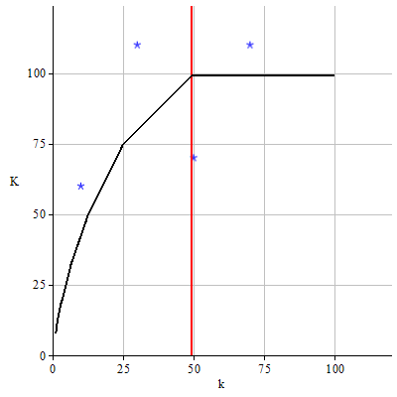
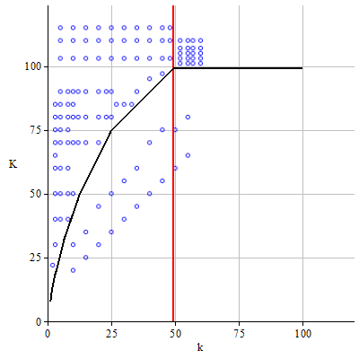
Theoretical predictions according to the parameters used
Treatment 1
Treatment 2

Slide 21
The experiment 3
Sets of payoffs are different across problems and subjects.
We use the procedure in Stecher et al (2011) to generate ambiguously distributed payoffs.
We ‘told’ the subjects how we generated the payoffs and showed them a comparison of ambiguous and uniform risky distribution.
The following payoff distributions were in the Instructions.
Each of the 49 plots are the distribution of 10,000 drawings from the relevant distribution.

Slide 22
Payoffs distribution – uniform risky distribution

Slide 23
Payoffs distribution – ambiguous distribution

Slide 24
The basic screen in the experiment

Slide 25
The experiment 4 - instruction
Subjects were told that if they clicked on the left-hand button, they would learn (and be paid) the lowest payoff.
Subjects were told that if they clicked on the middle button and specified an aspiration level, they would have to pay k and then they would be told whether there were or whether there were not payoffs greater than or equal to their chosen aspiration level. They could do this repeatedly and with different aspiration levels.
Subjects were told that if they clicked on the right-hand button they would learn the highest payoff and be paid that minus K.

Slide 28
For the experimenters
Software was written in Python, mainly by Paolo Crosetto.
We paid out some £13 on average for an experiment that lasted at most 1 hour.
We did not slow down or speed up the subjects.
The subjects were all from the University of York. There were only 5 subjects who have any work experience related to finance or economics, but most of them (34 subjects) had participated in an economics experiment before.

Slide 29
results
We start by showing a particular subject.

Slide 30
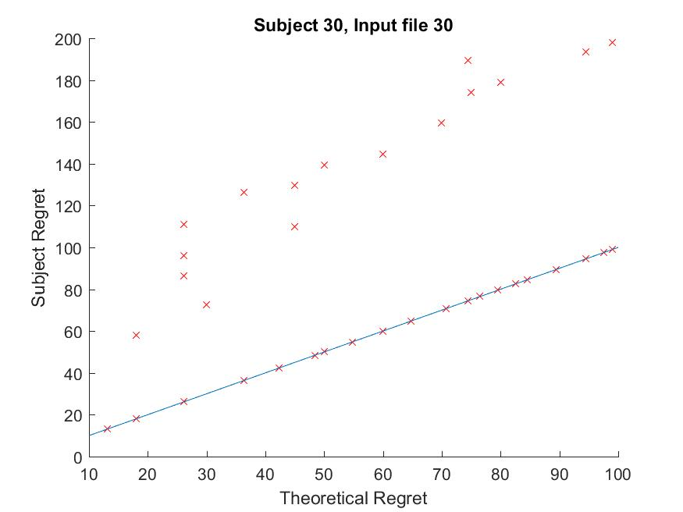

Slide 31
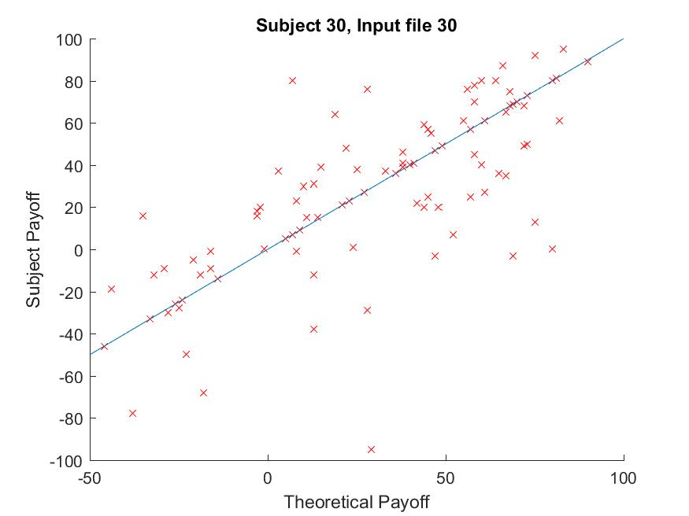

Slide 32
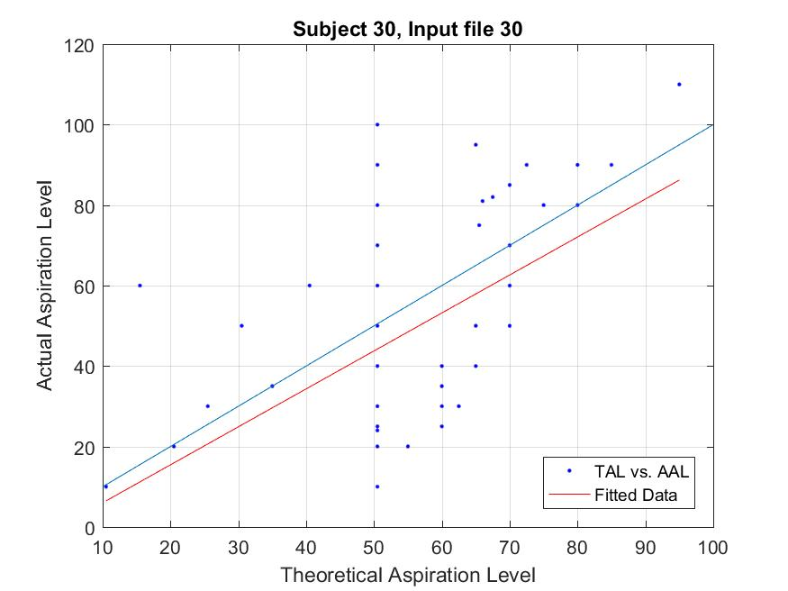

Slide 33
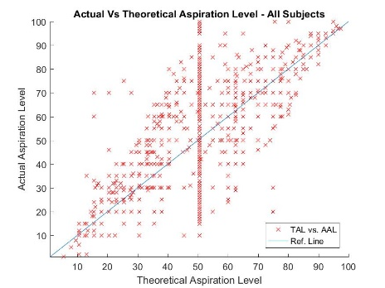

Slide 34
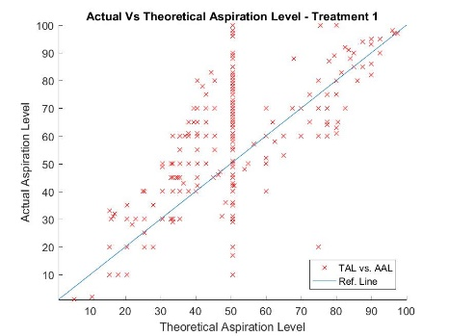

Slide 35
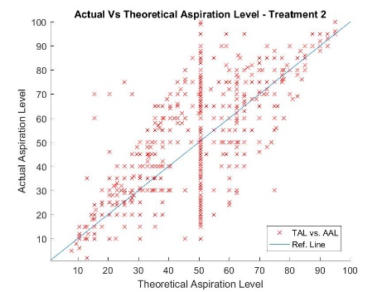

Slide 36
Actual compared to the theory: the ‘when’ part
 |  | Subjects choices
 |  | No Deliberation | Satisfice | Optimise | Totals
Manski’s theory | No Deliberation | 717 | 98 | 25 | 840
 | Satisfice | 1,079 | 1,895 | 146 | 3,120
 | Optimise | 598 | 161 | 81 | 840
 | Totals | 2,394 | 2,154 | 252 | 4,800
2,693 of 4,800 decisions (56.1%) are matched with the theoretical prediction

Slide 37
Rounds of satisficing: part of the ‘how’ part
Subjects’ choices – number of rounds of satisficing
Manski’s theory | M | 0 | 1 | 2 | 3 | 4 | 5 | 6 | 7 | 8 | 9 | 11 | Tots
 | 0 | 1448 | 200 | 19 | 8 | 1 | 2 | 1 | 0 | 0 | 0 | 1 | 1680
 | 1 | 852 | 312 | 46 | 8 | 4 | 0 | 0 | 1 | 0 | 1 | 0 | 1224
 | 2 | 132 | 163 | 34 | 7 | 0 | 0 | 0 | 0 | 0 | 0 | 0 | 336
 | 3 | 190 | 532 | 248 | 69 | 13 | 4 | 0 | 0 | 0 | 0 | 0 | 1056
 | 4 | 19 | 89 | 85 | 38 | 27 | 4 | 1 | 0 | 1 | 0 | 0 | 264
 | 5 | 18 | 71 | 67 | 44 | 26 | 10 | 1 | 2 | 0 | 1 | 0 | 240
 | Tots | 2659 | 1367 | 499 | 174 | 71 | 20 | 3 | 3 | 1 | 2 | 1 | 4800
Out of 3,120 problems in which subjects should satisfice, in only 452 problems (14.49% ) did the subjects chose the same number of rounds of satisficing as the theory predicts.

Slide 38
Actual vs theoretical aspiration level: All subjects
The coefficient of TAL is not significantly different from 1, but the intercept is significantly different from 0. The theory predicts reasonably well on average.

Slide 39
Actual aspiration level on the particular bounds: All subjects
The coefficient of particular bounds are significantly different from 0.5 indicating that the theory does not predict reasonably well on the average.

Slide 40
Summary of results
The average actual payoff (31.77) is higher than the average theoretical payoff (24.32).
The average actual regret (108.18) is higher than the average theoretical regret (65.7).
Subjects’ decisions in Treatment 2 are closer to the theoretical prediction (61.5%) than in Treatment 1(50.71%).

Slide 41
Conclusions
As to the three parts of Manski’s solution:
Subjects are not following the ‘when’ part
This is a difficult part
Subjects are partly following the first of the ‘how’ parts
This is a not-so-difficult part
Subjects are generally following the second of the ‘how’ parts
This is a relatively easy part

Slide 42
Discussion 1
Manski’s theory is an ex ante theory. It describes what the best strategy is as viewed from the start. The DM should implement their strategy as they work through the problem.
Our experimental involves subjects actually working through the problem and we can only observe what they actually do.
Should we not instead ask them to state their strategy, and then we implement it? (like strategy games).
But how do they state a strategy?
What is the payment scheme? (same as ours?)

Slide 43
Discussion 2
Do subjects have a different objective function (EU maximisation?) and are assuming something different about the distribution of payoffs (uniform risky)?
And what about the subjects’ thinking?

Slide 44
Thank you for listening and for your comments.

